Slide 1
TEAM 3
TEAM MEMBERS
KL SAIKRISHNA
MENEGA
HRISHIKESH S
SUJANA
BHAVANA R VINAYKUMAR

Slide 2
AGENDA
Hardware
Windows Fundamentals
Linux Fundamentals
Network Fundamentals
Network Services
Database
Applications
Storage

Slide 3
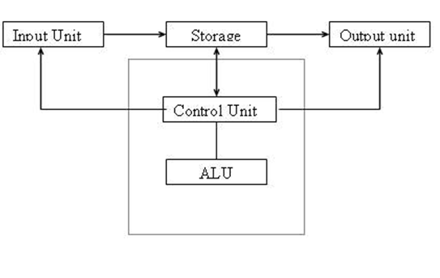
HARDWARE
What is Computer?
It has-
Input unit
Output unit
Storage
Control unit
ALU
Hardware :
Computer hardware are the physical parts or components of a computer, such as the monitor, keyboard, computer data storage, graphic card, sound card and motherboard. By contrast, software is instructions that can be stored and ran by hardware.

Slide 4

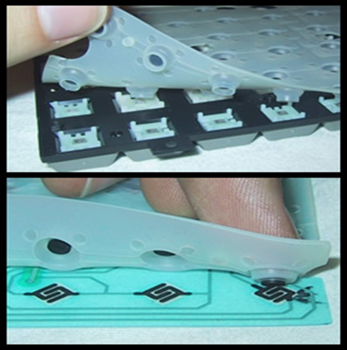
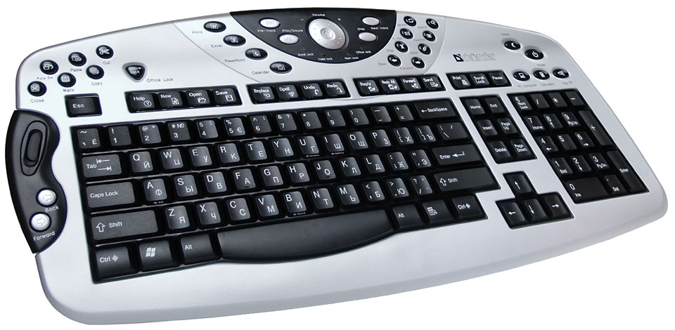
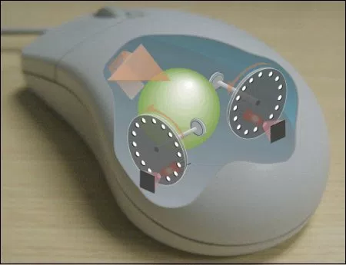
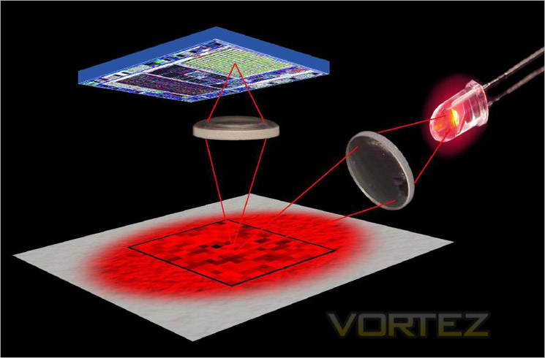

INPUT DEVICES
Keyboard
Types of keyboard
Mechanical
Membrane
multimedia
Mouse
Types of mouse
Mechanical
Optical
Wireless

Slide 5
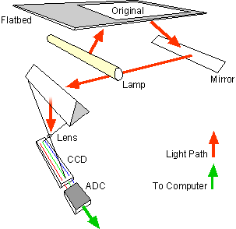
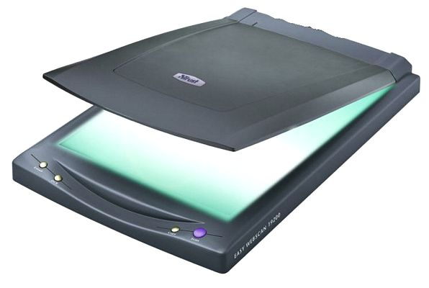
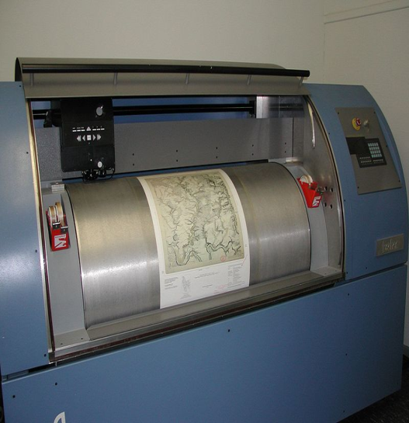
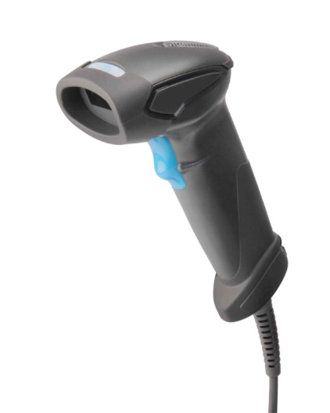
Working principle of scanner
SCANNER
Types of scanner
Flatbed scanner
Drum scanner
Handheld scanner
(Charge Coupled Device)
(Analog to Digital converter)

Slide 6
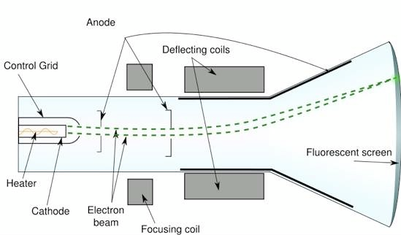
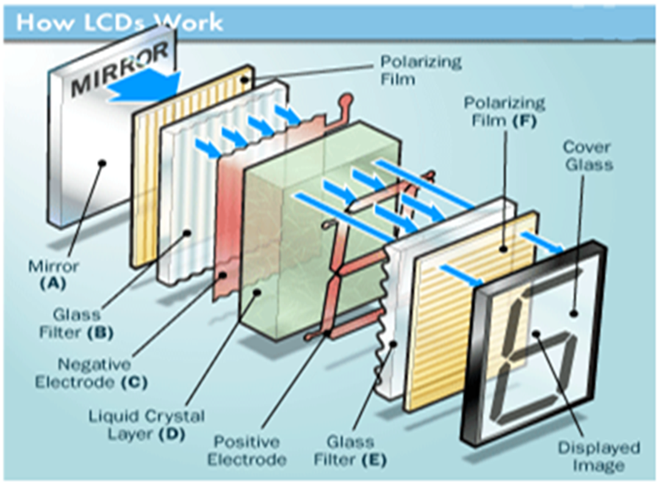
OUTPUT DEVICES
Monitor
CRT Monitor
LCD
LED

Slide 7
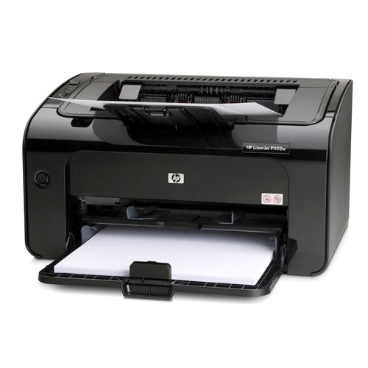
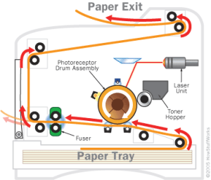
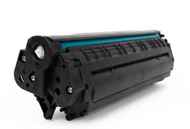
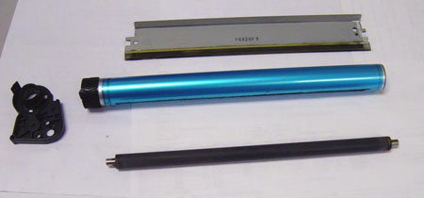
PRINTERS
Types of printers
1.Laser jet
2.Ink jet
3.Dot-Matrix
Components of laser jet
Tonner hopper
Laser unit
Drum assembly
Fuser
Paper tray
Laser Jet Printer

Slide 8
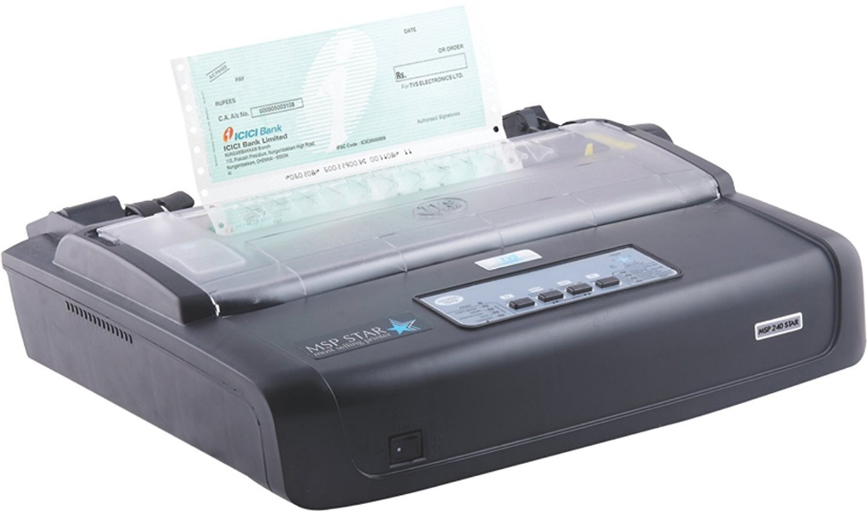
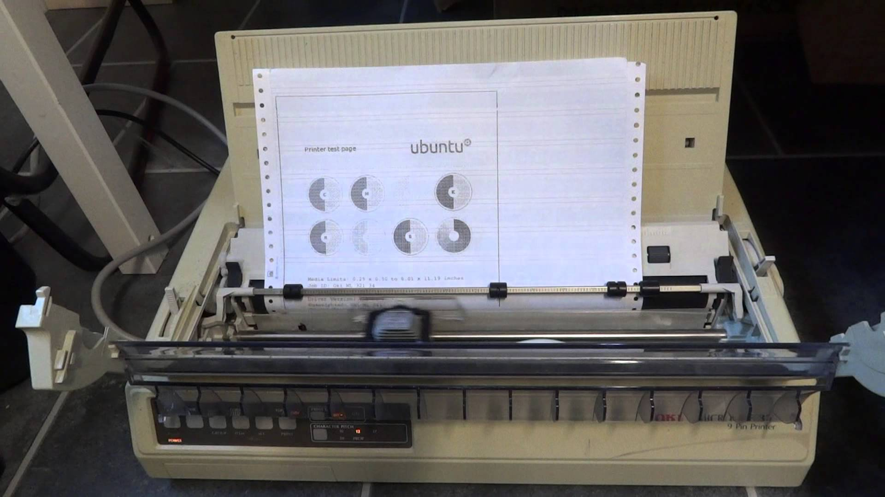
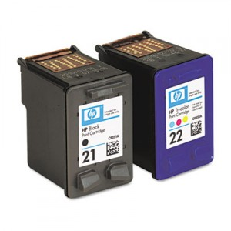
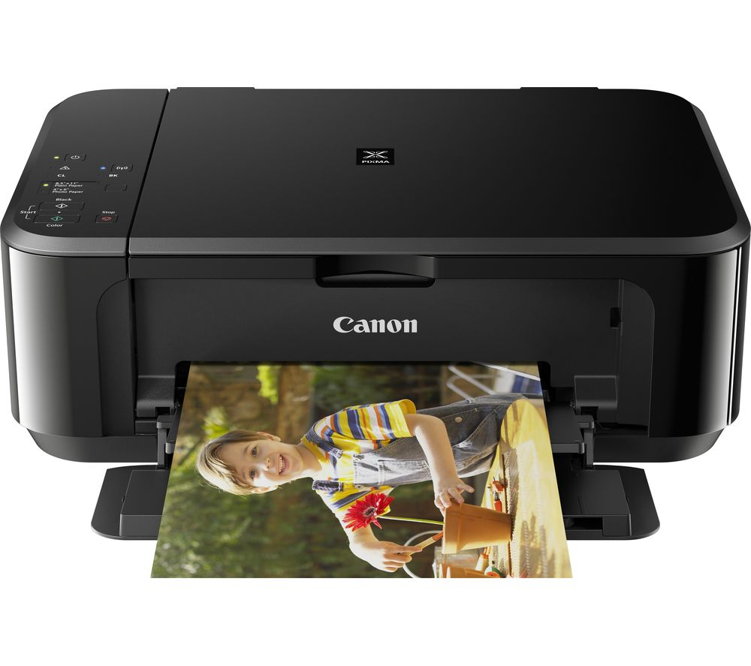
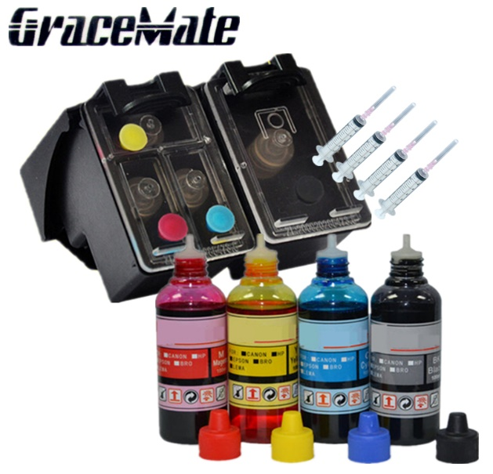
DOT MATRIX PRINTER
INK JET PRINTER

Slide 9
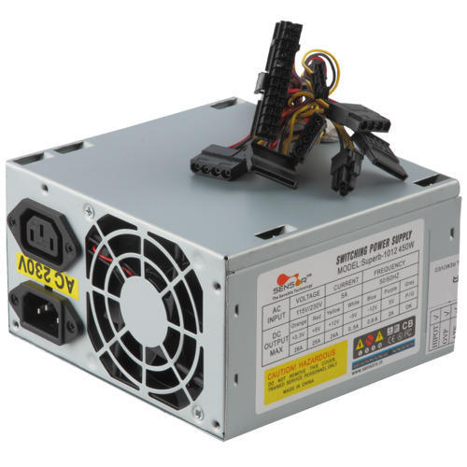
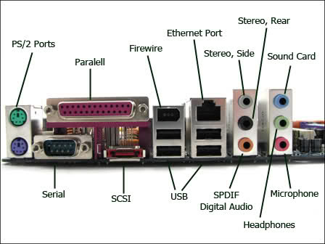
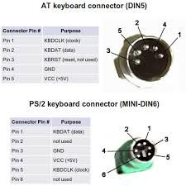
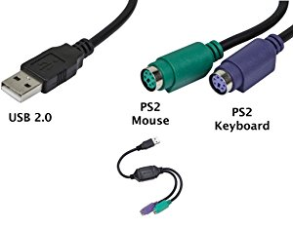
SMPS
Ports To Be Connected
Connectors

Slide 10
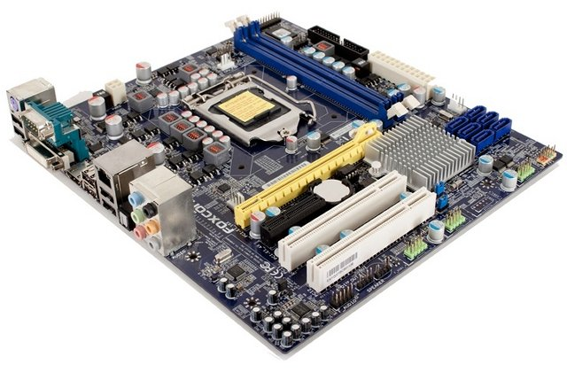
Motherboard
DIMM SLOT
CPU SOCKET
SATA CONNECTORS
SOUTH BRIDGE
CMOS BATTERY
BACK PANEL
(PERIPHERAL CONNECTORS)
PCI SLOT
FRONT PANEL CONNECTOR PINS
PCI XPRESS SLOT

Slide 11
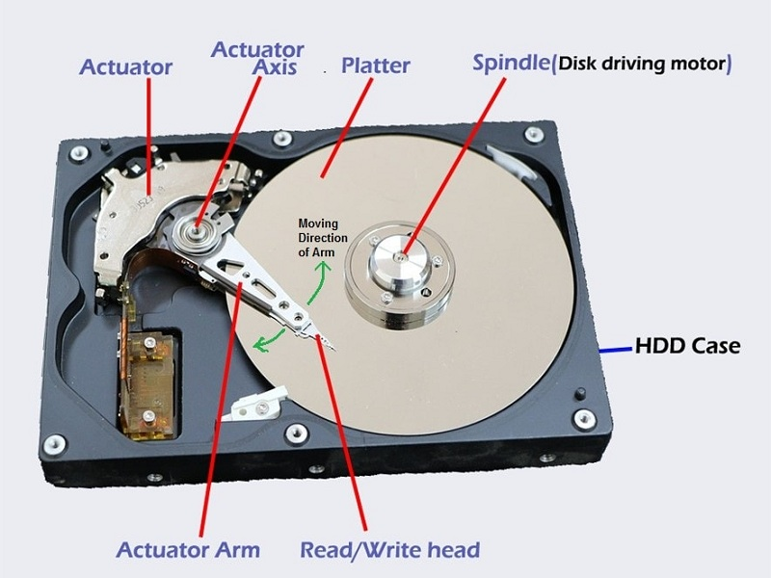
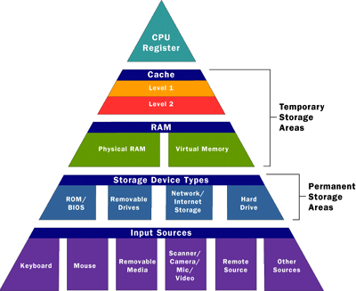
HARD DISK
Memory

Slide 12
WINDOWS FUNDEMANTALS

Slide 13
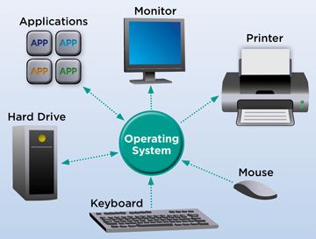
OPERATING SYSTEM
Operating system is an interface between software and hardware.
Types of OS
Embedded OS
Simple Batch OS
Real Time OS
Distributed OS

Slide 14
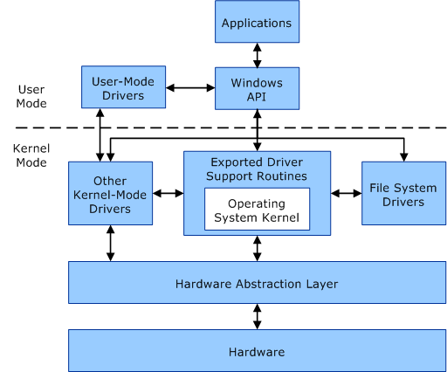
KERNEL ARCHITECHTURE
KERNEL : The kernel is a computer program that is the core of a computer's operating system
Types of Kernel
1.MICRO
2.MONO

Slide 15
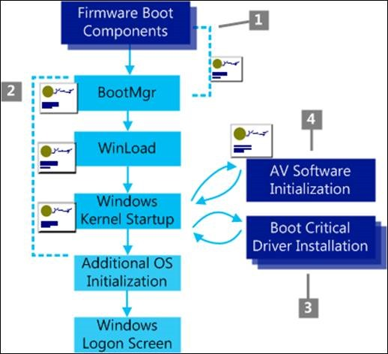
WINDOWS BOOTING PROCESS
Power On
BIOS
POST
MBR
Boot Loader
Windows Loader
Windows Kernel
Logon

Slide 16
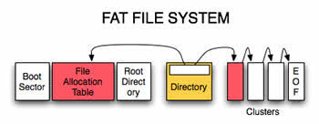
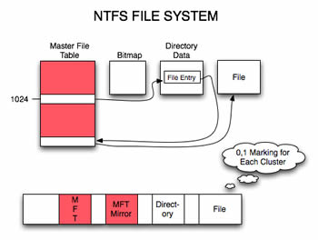
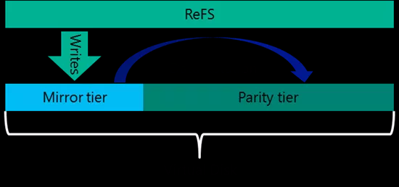

FILE SYSTEM

Slide 17
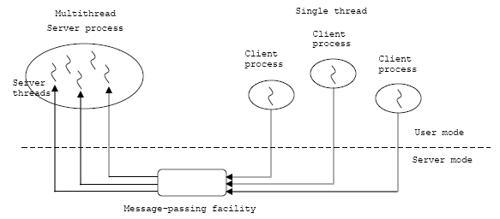
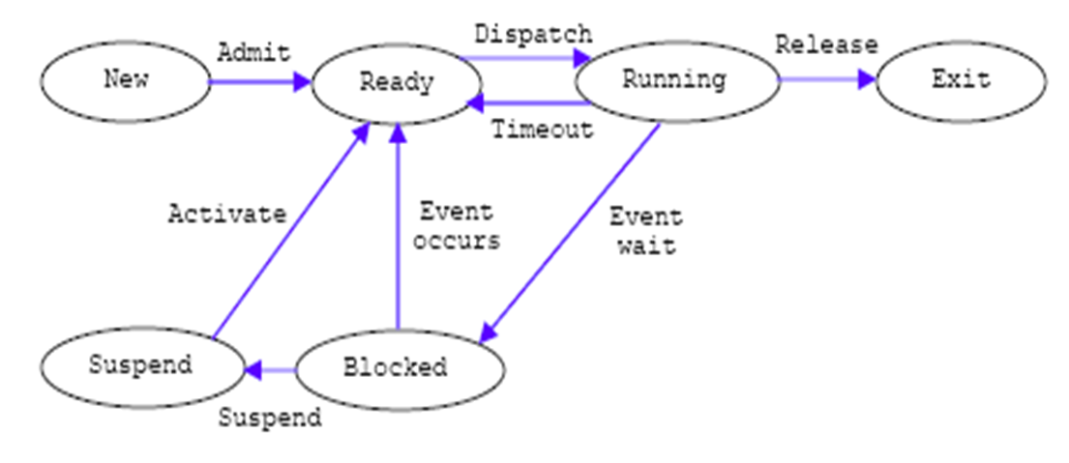
PROCESS MANAGEMENT
Process
A collection of one or more threads and associated system resources such as memory, open files and devices.
Threads
The smallest sequence of programmed instructions
Process States

Slide 18
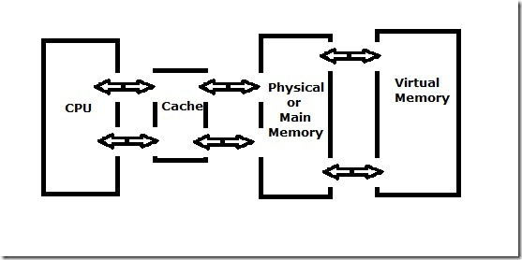
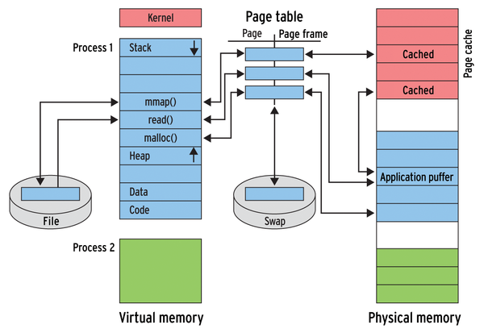
MEMORY MANAGEMENT

Slide 19
LINUX FUNDEMENTALS

Slide 20


Introduction:
Linux was introduces by Linus Torvalds in the year 1991.
Linux or, a Unix-like computer operating system assembled under the model of free and open-source software development and distribution.
Software Version
Alpha
Beta

Slide 21

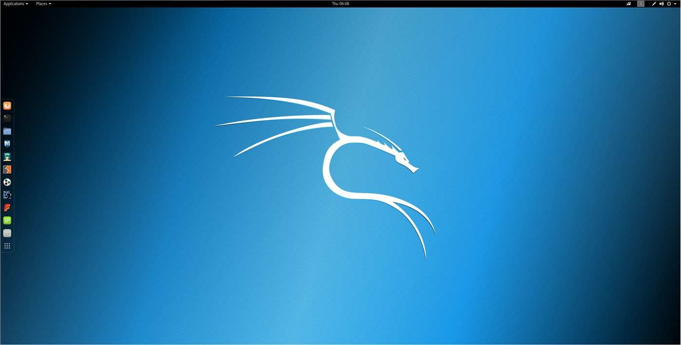




Linux Subsystem:
Linux
OS Services
USER Application
Linux Kernel
Hardware Controller

Slide 22
Linux Kernel
Memory Management
Virtual Files System
Process Scheduler
Inter-process Communication
Run Levels
0- Halt.
1-Single User Mode.
2-MultiUser mode without Network.
3-Full multiuser Mode.
4-Unused.
5-X11.
6-Reboot.
Network Interface

Slide 23
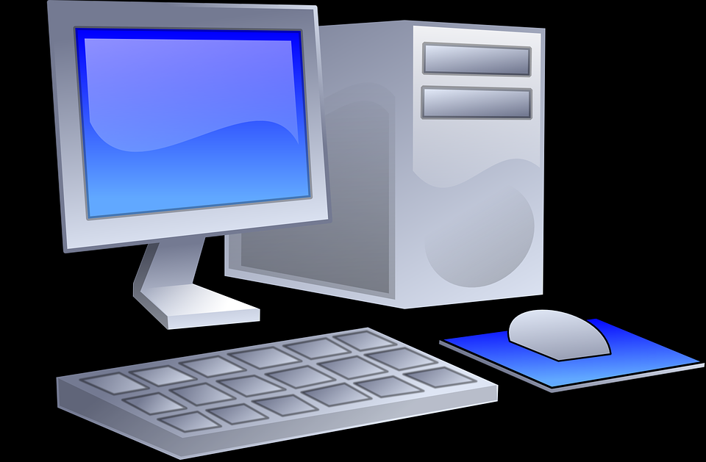
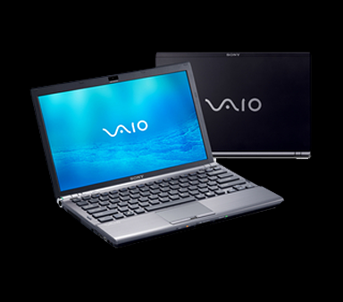
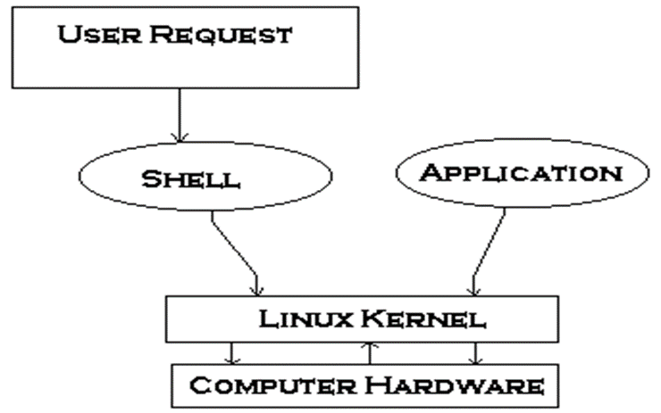
Booting Process
BIOS
MBR
GRUB
KERNEL
RUN LEVEL
INIT
Shell
Types Of Shell
Ash.
Bourne.
BASH.
T-Shell.
C-Shell.
Z-Shell.

Slide 24
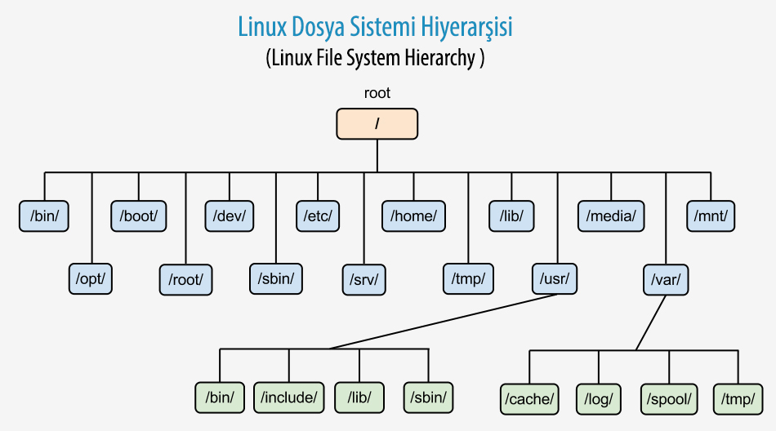
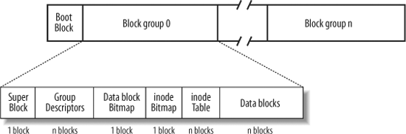
File Management
Types of Linux File System.
1.Ext 2.
2.Ext 3.
3.Ext 4.
Journaling.
1.Write back.
2.Ordered.
3.Data.

Slide 25
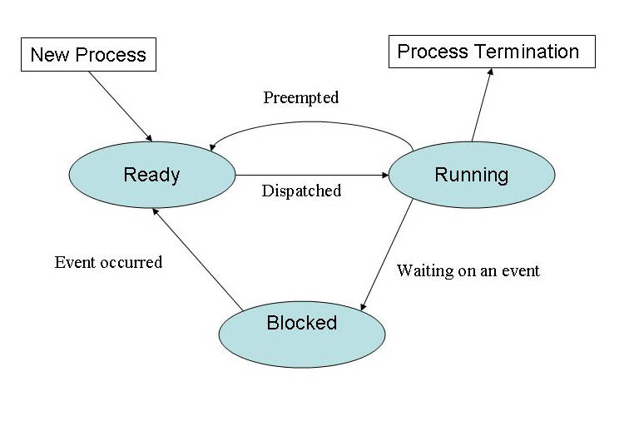
Process Management
Types of process
Init process.
Parent process.
Child process.
Daemon process.
Orphan process.
Zombie process.
Interactive process.
Batch process.
Real time process.
Types of Process Scheduling
FCFS (First Come First Serve).
SJF (Shortest Job First).
Round Robin.
Priority Scheduling.

Slide 26
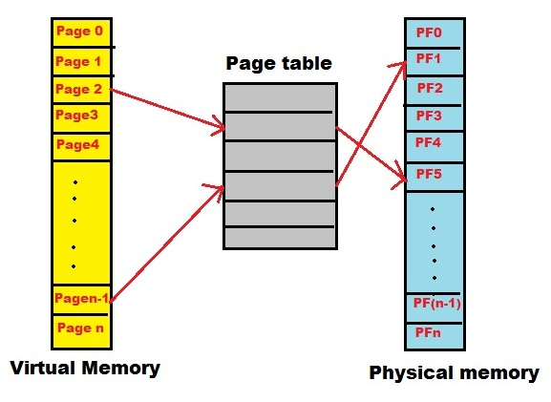
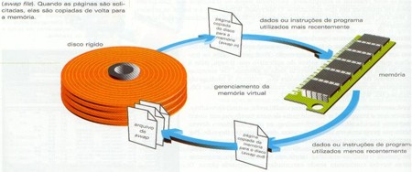
Device Management
Block Device
Character Device
Device Management .
Device files (/dev).
IRQ.
Memory Management
Memory Management
Buddy System
LRU

Slide 27
NETWORK FUNDEMANTALS

Slide 28
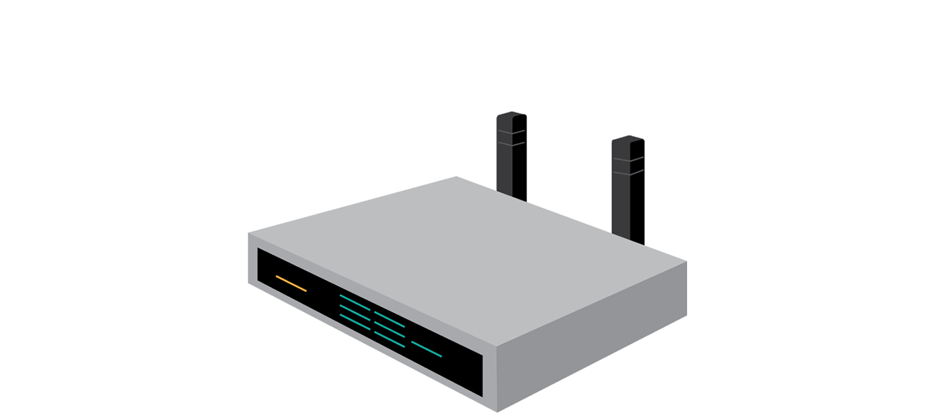
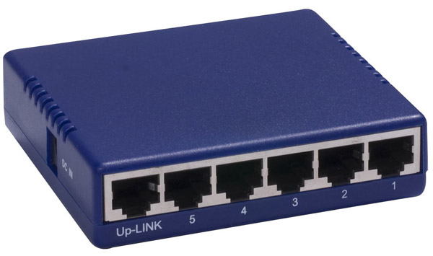
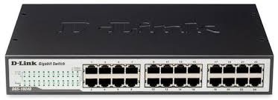
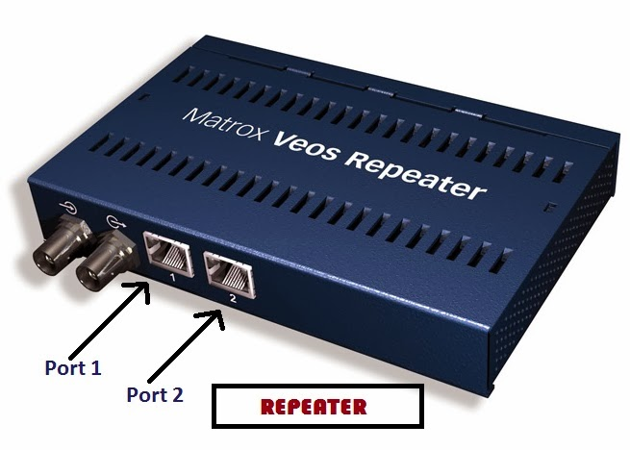


NETWOTK DEVICES
These are the components which is used to connect the computer together so that the data can be shared.
Switch
Router
HUB
Bridge
Repeater
NIC

Slide 29






TYPES OF NETWORKS

Slide 30


NETWORK TOPOLOGIES

Slide 31

TCP/IP LAYERS AND OSI LAYERS

Slide 32

IP ADDRESS CLASSES

Slide 33
NETWORK SERVICES

Slide 34



DHCP
Used to dynamically assign an IP address to any node
ADVANTAGES
TECHNOLOGIES PRIOR TO DHCP
STEP BY STEP PROCESS
DISCOVER
OFFER
REQUEST
ACKNOWLEDGE

Slide 35

DNS
The Domain Name System (DNS) is a hierarchical decentralized naming system for computers, services, or other resources connected to the Internet or a private network.

Slide 36

DIRECTORY SERVICES
Directory services contain data and metadata
X.500 formed the basis of a standard that is widely deployed known as LDAP

Slide 37

MAIL SERVICES
An application that receives incoming e-mail from local users and remote senders and forwards outgoing e-mail for delivery.
MTA
MUA
SMTP
POP3
IMAP4

Slide 38

PROXY SERVICES
Acts as an intermediary between the user's computer and the Internet
Proxy caching is a feature of proxy servers that stores content on the proxy server itself, allowing web services to share those resources to more users.

Slide 39

WEB SERVICES
It’s a service offered by an electronic device to another electronic device, communicating with each other via the World Wide Web.

Slide 40
APPLICATIONS

Slide 41
APPLICATIONS
An application program is a computer program designed to perform a group of coordinated functions, tasks, or activities for the benefit of the user.
PRESENTATION LAYER
BUSINESS LOGIC LAYER
DATA ACCESS LAYER
COMPONENTS
COMPILER
INTERPRETER
TYPES:

Slide 42

APPLICATIONS - LIFE CYCLE

Slide 43

API
An application program interface (API) is code that allows two software programs to communicate with each other.
TYPES OF ATTACKS:
SQL injection
cross-site scripting
Denial-of-service
Session hijacking

Slide 44





Slide 45

ENTERPRISE APPLICATIONS

Slide 46
DATABASE FUNDAMENTALS

Slide 47
DBMS
It is responsible for creating, editing, deleting and generally maintaining a database or collection of data records.
A database model is the manner in which the data collection is stored, managed and administered.
Different data models:
Flat file based database management systems
Hierarchical database management systems
Network database management systems
Object oriented database management systems
Relational database management systems

Slide 48

File based approach Disadvantages:
DBMS advantages:
Integrity problems
Consistency
Concurrent access
Integrity
Data redundancy
Recovery services
Data Inconsistency
Controlling Redundancy
Atomicity Problems
Restricting unauthorized access
ACID PROPERTIES:
Concurrency Control

Slide 49

RDMS
Null constraint
Not null constraint
Unique constraint
Default constraint
Primary key constraint
Foreign key constraint

Slide 50


NORMALIZATION
1 NF
item | Color | Price | tax
samsung | red, blue | 5000 | 0.25
motorola | Black, white | 4000 | 0.25
item | Color | Price | tax
samsung | Red | 5000 | 0.25
samsung | Blue | 5000 | 0.25
motorola | Black | 4000 | 0.25
motorola | white | 4000 | 0.25
2 NF

Slide 51

3 NF
BCNF
item | Color
samsung | Red
samsung | Blue
motorola | Black
motorola | white
item | Price
samsung | 5000
motorola | 4000
Price | tax
5000 | 0.25
4000 | 0.25

Slide 52
STRUCTURED QUERY LANGUAGE SQL is a standard computer language for relational database management and data manipulation.
SQL language statement
DDL
DML
DCL
TCL
Create
Alter
Truncate
Drop
Insert
Update
Delete
Select
Grant
Revoke
Commit
Rollback

Slide 53

GENERAL RDBMS ARCHITECHTURE
Application layer
Logical layer
Physical layer

Slide 54
STORAGE

Slide 55

STORAGE
Storage means the devices and data connected to the computer through I/O operations.
Components of Storage System Environment
Hosts
Connectivity
Bus, Port, Cable
Storage arrays
Magnetic media, Optical media, Solid State media

Slide 56
Types of Storage
Direct attached Storage (DAS)
Network Attached Storage (NAS)
Storage Area Networks (SAN)
Redundant Array of Independent Disk (RAID)

Slide 57

DAS
Direct-attached storage (DAS) is digital storage directly attached to the computer accessing it, as opposed to storage accessed over a computer network.
NAS
A Network Attached Storage (NAS) device is a storage device connected to a network that allows storage and retrieval of data from a centralized location
SAN
SAN serves to interconnect storage related resources that are connected to multiple servers.
It uses Fiber Channel Technology.
It also uses iSCSI.

Slide 58


RAID 0 and RAID 1

Slide 59


RAID 5 and RAID 6

Slide 60


RAID 01 and RAID 10

Slide 61

Thank You

